Slide 1



BIOSENSOR AND
IT’S APPLICATION
(Satvik Shukla21SCSE1010146)
(Saurabh Kumar sah21SCSE1011305)
(Shivam Dwivedi 21scse1010662)
(Saurabh Sharma21SCSE1010780)

Slide 2
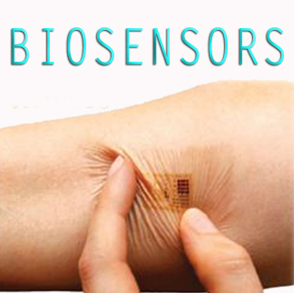

Slide 3
Introduction
A biosensor is a sensing device comprised of a combination of a specific biological element and a transducer.
A specific biological element recognizes a specific analyte and the changes in the biomolecule are usually converted into and electrical signal ( which is in turn calibrated to a specific scale ) by a transducer.
It detects, records and transmits information regarding a physiological change or process.

Slide 4
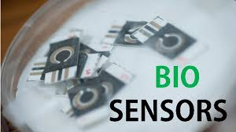
Definition
A biosensor is an analytical device, used for the detection of an analyte, that combines a biological component with a physicochemical detector.

Slide 5
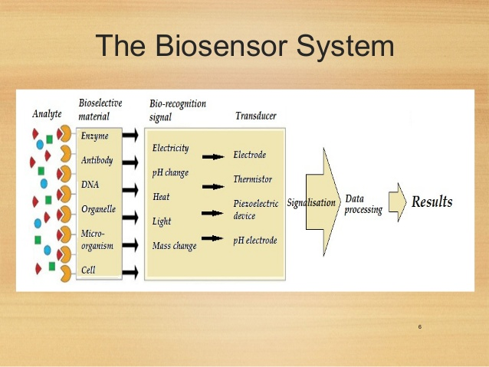
Biosensor system

Slide 6
A successful biosensor must possess at least some of the following beneficial features:
The biocatalyst must be highly specific for the purpose of the analyses, be stable under normal storage conditions and, except in the case of colorimetric enzyme strips
The reaction should be as independent of such physical parameters as stirring, pH and temperature as is manageable. This would allow the analysis of samples with minimal pre-treatment.
The response should be accurate, precise, reproducible and linear over the useful analytical range, without dilution or concentration. It should also be free from electrical noise.

Slide 7
Types Of Biosensors
Electrochemical biosensor
Optical biosensor
Thermal biosensor
Resonant biosensor
Ion-sensitive biosensor

Slide 8
Electrochemical biosensor
Principle:
Many chemical reactions produce or consume ions or electrons which in turn cause some change in the electrical properties of the solution which can be sensed out and used as measuring parameter.
Classification:
Amperometric Biosensors
Conductimetric Biosensors
Potentiometric Biosensors

Slide 9
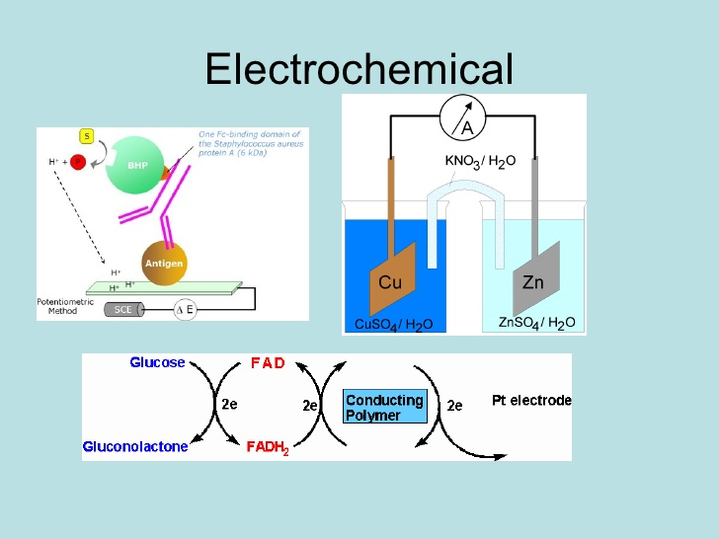
Electrochemical biosensor

Slide 10
Amperometric Biosensors
The high sensitivity biosensor can detect electro-active species present in biological test samples.
Since the biological test samples may not be intrinsically electro-active, enzymes are needed to catalyze the production of radio-active species.
In this case, the measured parameters is current.

Slide 11
Conductimetric Biosensors
The measured parameter is the electrical conductance resistance of the solution.
When electrochemical reactions produce ions or electrons, the overall conductivity or resistivity of the solution changes. This change is measured and calibrated to a proper scale (Conductance measurements have relatively low sensitivity).
The electric field is generated using a sinusoidal voltage (AC) which in minimizing undesirable effects such as Faradaic process, double layer charging and concentration polarization.

Slide 12
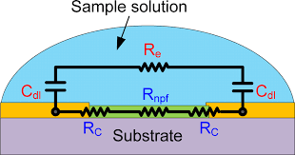
Conductimetric biosensor

Slide 13
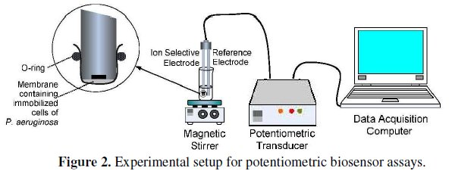
Potentiometric biosensor

Slide 14
Optical detection biosensor
The output transduced signal that is measured is light for this type of biosensor.
The biosensor can be made based on optical diffraction. In optical diffraction based devices, a silicon wafer is coated with a protein via covalent bonds. The wafer is exposed to UV light through a photo-mask and the antibodies becomeinactive in the exposed regions. When the diced wafer chips are incubated in an analyte, antigen-antibody bindings are formed in the active regions , thus creating a diffraction grating. This grating produces a diffraction signal when illuminated with a light source such as laser. The resulting signal can be measured.

Slide 15
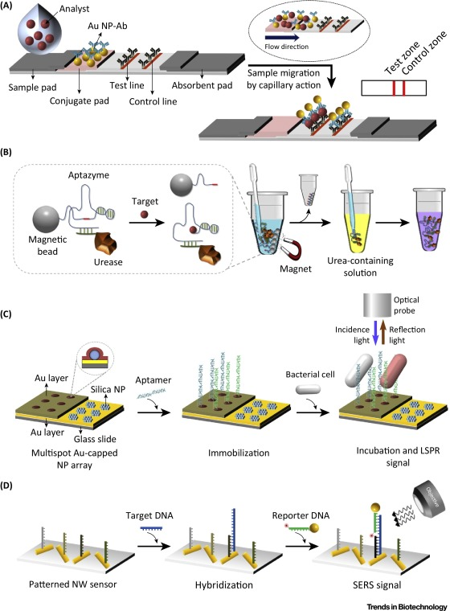
Optical detection biosensor

Slide 16
Thermal detection biosensors
This type of biosensor work on the fundamental properties of biological reactions, namely absorption or production of heat , which in turn changes the temperature of the medium in which the reaction takes place.
They are constructed by combining immobilized enzymes molecules with the temperature sensors. When the analyte comes in contact with the enzyme is measured and is calibrated against the analyte concentration.
The total heat produced or absorbed is proportional to the molar enthalpy and the total number of molecules in the reaction.

Slide 17
Conclusion
As the potential threat to bioterrorism increase, there is great need for a tool that can quickly, reliably and accurately detect contaminating bio-agents in the atmosphere.
Biosensors can essentially serve as low-cost and highly efficient devices for this purpose in addition to being used in other day-to-day application.
Biosensors are known as immuno-sensors,optrodes, chemical, canaries, resonant mirrors, glucometers biochips bio-computers and so on.

